Slide 1
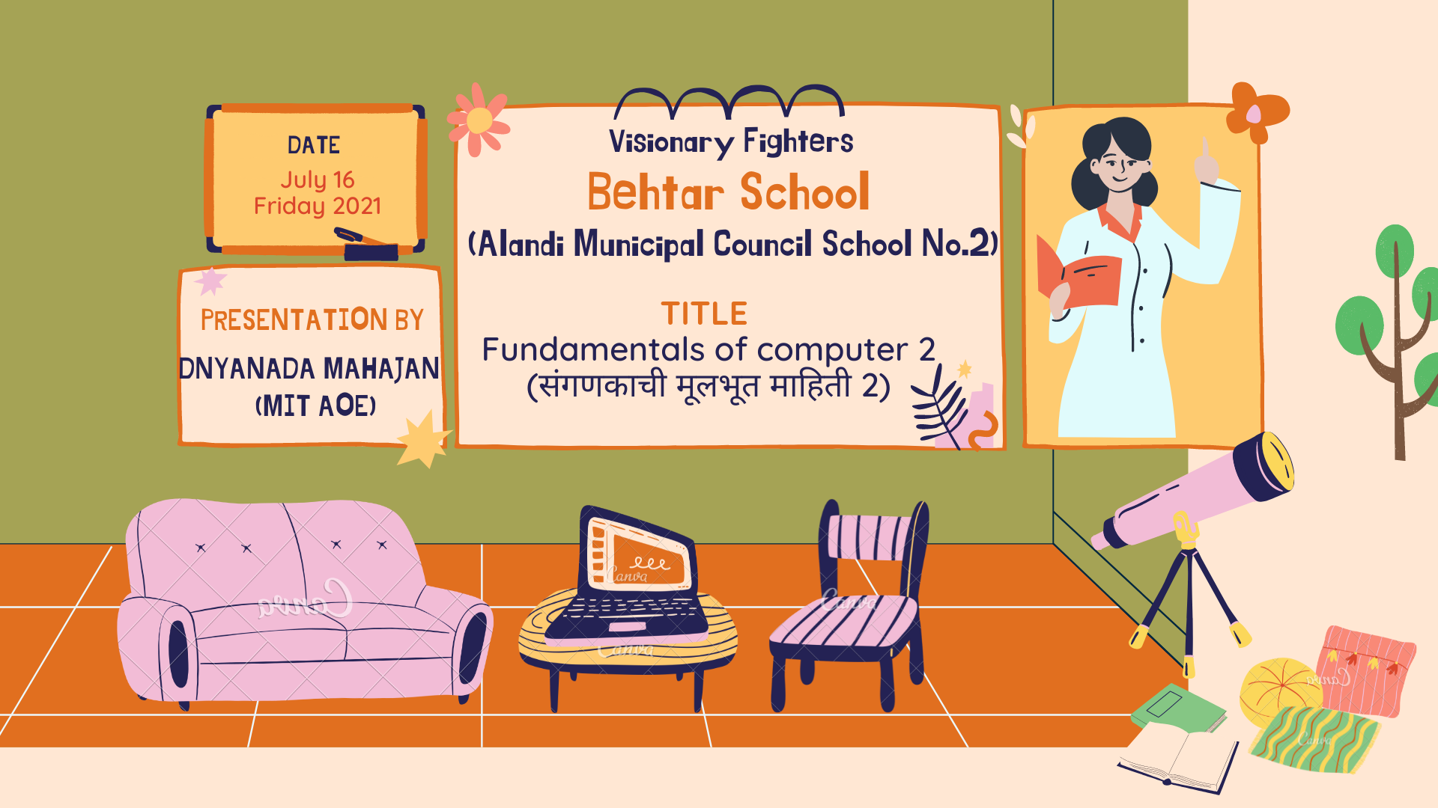

Slide 2

FUNDAMENTALS OF COMPUTER 2

Slide 3
Evolution of Computer
The computer started as a huge electronic device which took a large area, and the mechanism was very complicated.
In the course of time, those huge machines were converted into smaller versions, starting with the monitors, then laptop and later on the invention of tablets.
The first fully electronic computer was introduced in the 1930s, and since then, the development of computer and its related devices has been unstoppable.

Slide 4
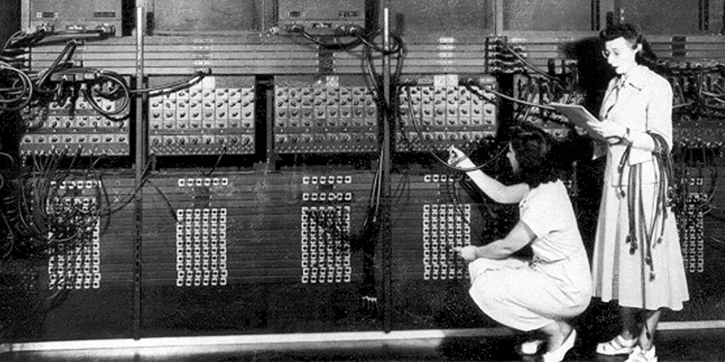

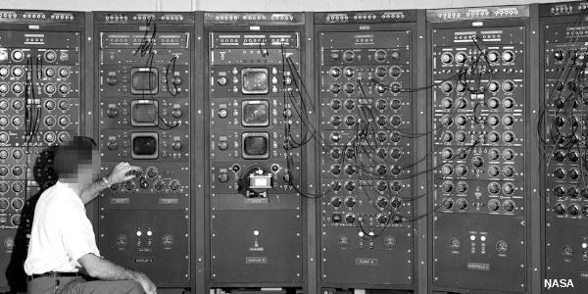
Images of world’s first computer

Slide 5

Generations of Computer
There are a total of five Generations of Computer, with each Generation something new was discovered to improvise the functioning and the use of the computer systems.

Slide 6
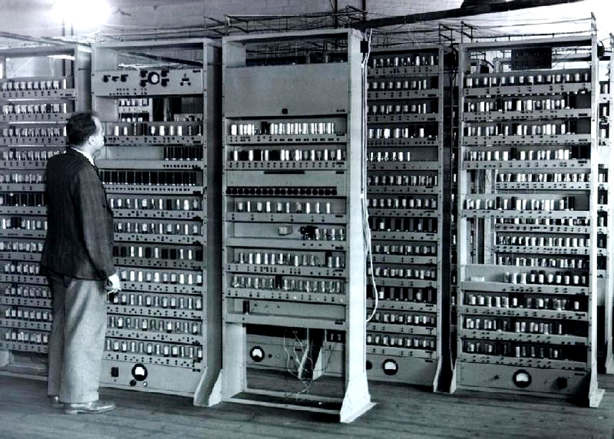
First Generation computers (1940-1956)
This Generation computers relied on Machine Language (the Language of 0s and 1s) and used Vacuum tubes as components of memory.
They were huge in size and occupied almost a room-size area to fit in

Slide 7
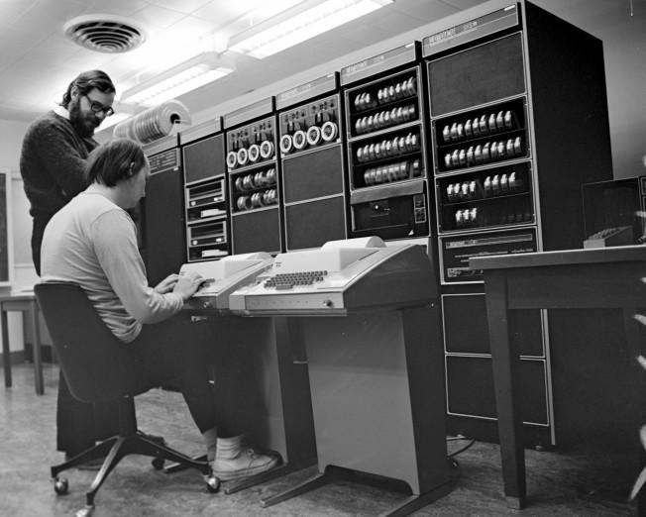
Second Generation computers (1956-1963)
The Second Generation computers used transistors, the speed of the transistor decided the speed of the computer.
It was less expensive in comparison to the 1st Generation computers and took comparatively less space.

Slide 8
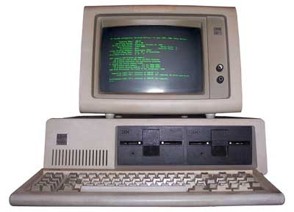
Third Generation computers (1964-1971)
The phase when the usage of keyboards and monitors ha started for the input and output.
The transistors had been reduced in size and were placed on silicon chips. This increased the speed of the computer.

Slide 9
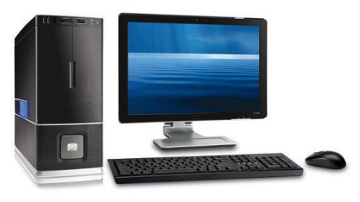
Fourth Generation computers (1972-2010)
The maximum developments were done during this time phase as technology has advanced many folds.
By this time, millions of transistors could be placed on the silicon circuits.

Slide 10
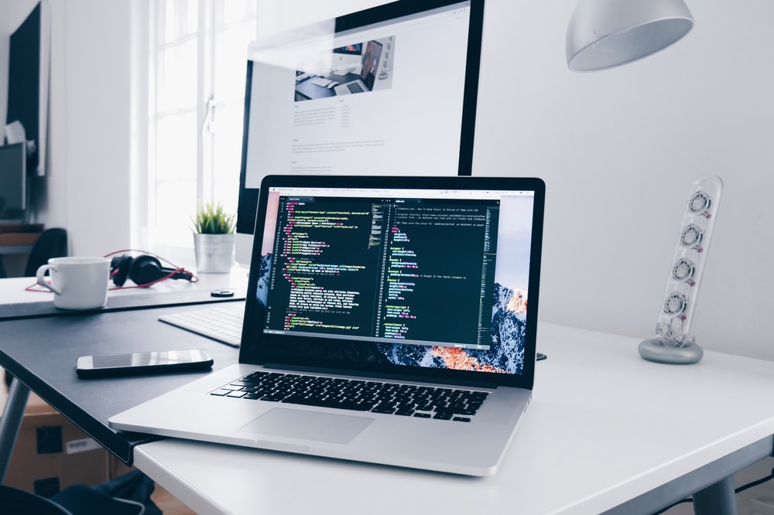
Fifth Generation computers (2010-till date)
The current generation of computers which have made our lives easier and more convenient is all a part of the fifth generation of the computer.

Slide 11
Types of Computer
There are majorly 4 types of computers which have been described briefly.

Slide 12

Super computers
Supercomputers are the fastest and the most expensive computers. These huge computers are used to solve very complex science and engineering problems.

Slide 13
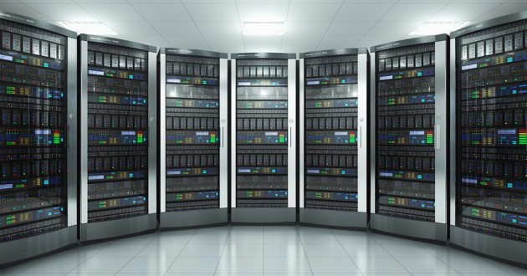
Mainframe computer
Computers designed to be used in large firms and organizations where a lot of people have to work on the same database are called mainframe computers.
They are mostly used in Banks.

Slide 14
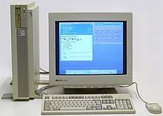
Workstation Computer
Usually a single user system is called a work station. The RAM for such systems is more, and the processors are quite fast.
They are mostly used by an individual and can be used for multiple purposes.

Slide 15

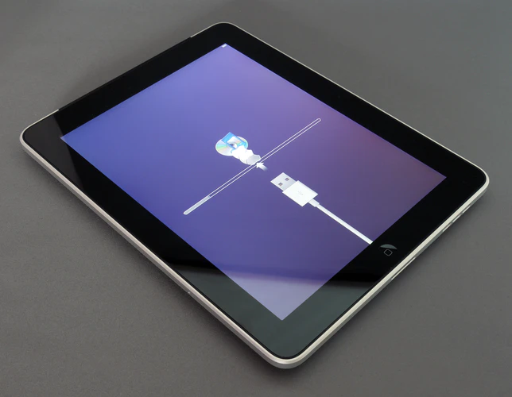
Microcomputer Computer
Designed for personal use only. This type of computers can easily be moved from one place to the other.
They have a personal storage area, input & output unit and a Central Processing Unit.
Examples for microcomputer are desktop, laptop, mobile phone, tables, etc.

Slide 16


